Slide 1

Student Result Management System
Software Engineering
ESC501
ARKAPRATIM GHOSH
13000121058
CSE-A

Slide 2
TABLE OF CONTENTS
Introduction
Scope of the problem
Objective
Problem Statement
Customer Survey
Functional Requirements
Non-Functional Requirements
Benefits
Conclusion
References

Slide 3
Introduction
Introducing the Student Result Management System (SRMS), revolutionizing how we manage academic outcomes.
SRMS offers educators an intuitive platform to input, track, and analyze student performance effectively.
Experience instant result updates through SRMS, ensuring swift access to vital academic information.

Slide 4
Scope of the Problem
Manual result handling is error-prone and time-consuming, affecting efficiency and accuracy.
Lack of a centralized system leads to difficulties in sharing results promptly with students and parents.
As institutions grow, managing results without an automated system becomes increasingly unwieldy.

Slide 5
Objective
Establishing a centralized platform for quick and transparent result sharing among educators, students, and parents.
Creating a flexible system that can adapt to the needs of educational institutions as they grow.
Developing a system to automate result management, reducing errors and saving time.

Slide 6



Problem Statement
To tackle the drawbacks of manual student result management and improve overall efficiency, the project aims to implement a comprehensive and automated Student Result Management System.

Slide 7
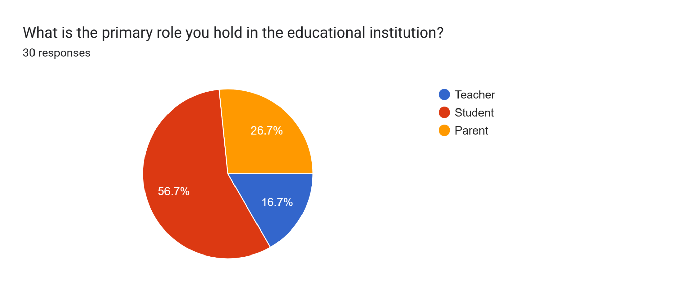
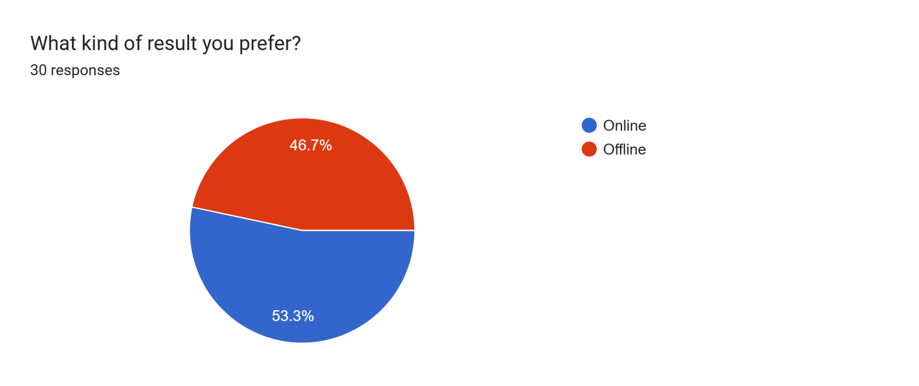
Customer Survey
Link: https://forms.gle/9i6cnpJvcVoDN6P48

Slide 8
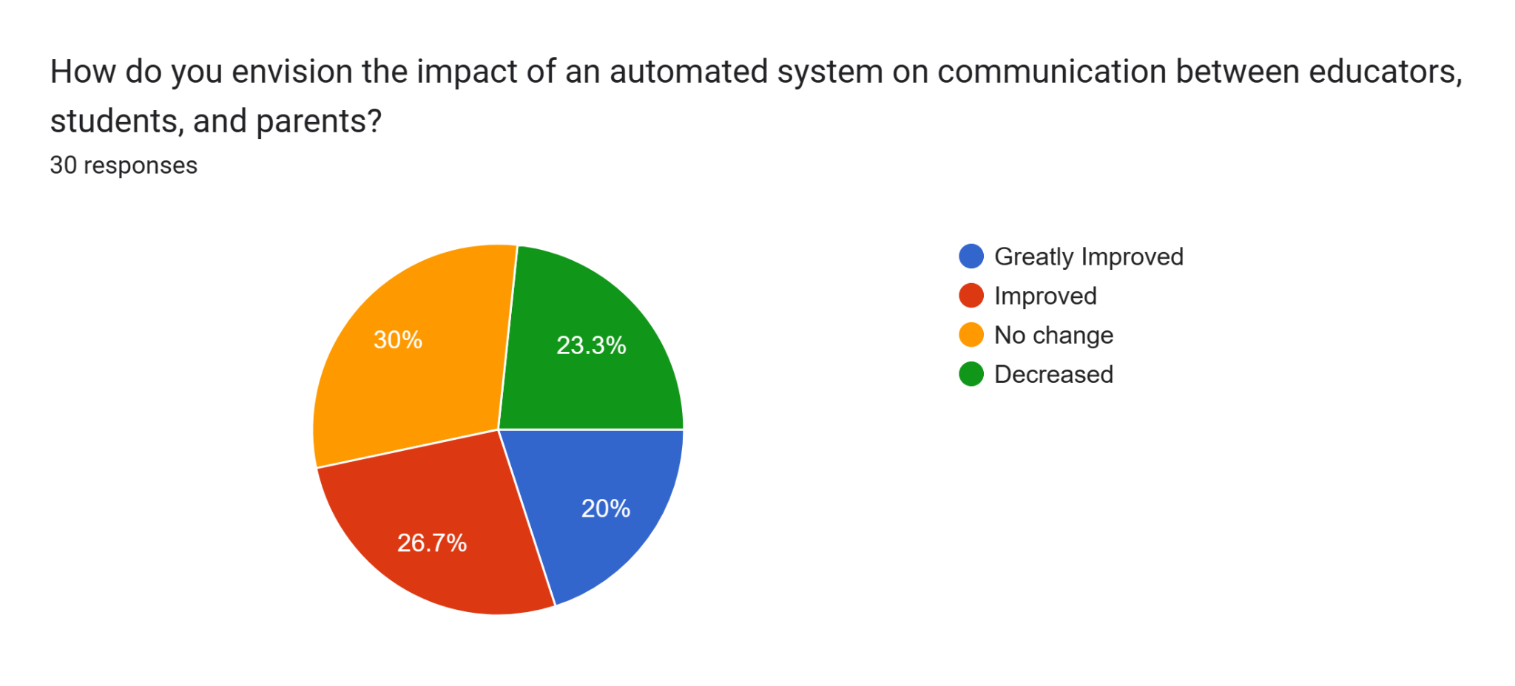
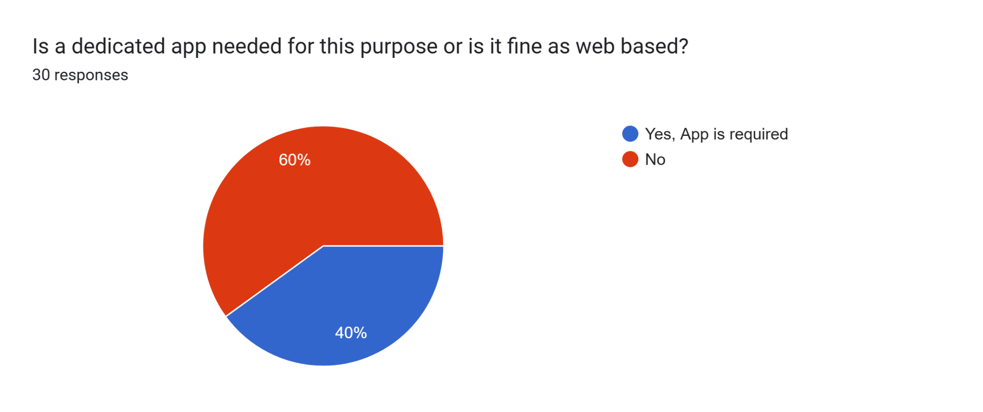
Customer Survey (Continued)

Slide 9
Functional Requirements
User Authentication and Access Control
Implement secure login credentials for administrators, teachers, students, and parents.
Ensure different roles have appropriate access permissions.
Result View and Management
Develop an user-friendly interface that enables teachers and students to view and modify results.
Communication platform
Develop a feedback portal or any messaging system for seamless discussion of results or any other queries.
Data Security and Privacy
Data encryption protocols to ensure protection of sensitive student information.

Slide 10
Non-functional Requirements
Correctness Requirement
Grades and result data accurately reflect the students' actual performance.
Portability Requirement
Easily deployable across various platforms and devices.
Efficiency Requirement
Deliver quick response times while handling multiple users and data.
Usability Requirement
Offer an user-friendly interface for all types of users.
Reusability Requirement
The system's components should be designed for easy integration.
Reliability Requirement
Should consistently ensure uninterrupted access to results and data
Maintainability Requirement
The system's code and architecture should be well-documented.

Slide 11
Benefits
Real-time notifications keep all stakeholders informed about new results and announcements.
Easily accommodates the growing number of students and courses without compromising performance.
Automation minimizes manual errors, ensuring precise recording and calculation of results.
Instant result sharing fosters transparent interaction between educators, students, and parents.

Slide 12
Conclusion
The Student Result Management System stands as a transformative solution to the challenges posed by traditional manual result handling
This system addresses inefficiencies, enhances transparency, and empowers stakeholders with valuable insights.
The journey from manual record-keeping to an automated, user-friendly platform is a stride towards a more efficient, accurate, and engaging academic experience.
Accessible performance insights motivate students to excel and take ownership of their progress.
Customizable and scalable, the system caters to institutions of varying sizes and structures.

Slide 13
References
(PDF) Student Result Management System (SRMS) (researchgate.net)
2021-V12I757.pdf (jespublication.com)
What is Student Result Management System? Advantage & Disadvantage (edusys.co)
Student Result Management system (4).pdf (uiu.ac.bd)

Slide 14

Thank you!

